Slide 1
Software-as-a-Service

Slide 2
Software As a Service
On-demand software developed, hosted and managed by the vendor
Largest segment of the cloud market
Accelerated by Web 2.0, RIA
Beware – Internet != Cloud
Most vendors offer:
Customization
Small release cycles (SalesForce releases every 3 months)
Web services interfaces
Collaboration
No flexibility

Slide 3
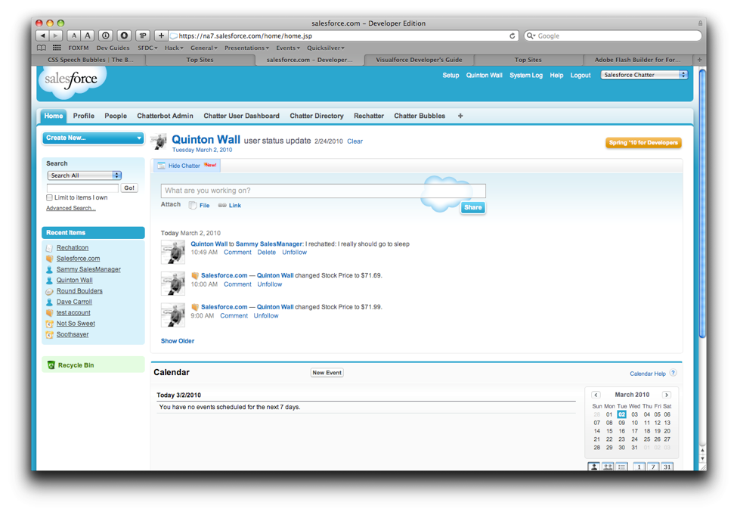
SalesForce
Leader in SaaS in CRM vertical
Browser, mobile and tablet based interfaces
CRM
Chatter - Sales
Collaboration
Groups
Feeds
App Updates
Sharing model

Slide 4
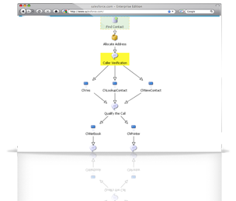
SalesForce
Customer Service Cloud
Provide faster service with this SaaS customer service product
Workflow Definitions and Automations
Contracts & Entitlements
Reporting
RemedyForce
Partnership with BMC to provide their ITIL service platform for core helpdesk capabilities
Radian6
Social Media analysis, CRM, tracking, monitoring, engagement

Slide 5
Microsoft Office 365
Microsoft Office collaboration & productivity tools delivered through the cloud
Email & Calendar
Business class security
Sharepoint Online
Collaboration, document management portal
Lync Online
Audio, Video Conferencing, IM
Office Web Apps
Word, Excel, Powerpoint, OneNote in your browser
99.9% uptime guarantee

Slide 6
Zoho
Email
CRM
Word Processor, Spreadsheet
Project Management
Invoice Management
Applicant Tracking System
Polls
Integrations with other platforms

Slide 7
37Signals
Model of Simplicity
Basecamp – Project Management
Highrise – Manage contacts
Backpack – Intranet
Campfire – Business chat rooms

Slide 8
Google Apps
Over 3 million businesses use Google Apps
Freemium model
Let us look closely at Google Apps offerings…

Slide 9
How to adopt SaaS Model?
Requirement Analysis
Automation, Metering, Logging
Scalability & Multi-tenancy
SaaS Enablement
Application Architecture
UI Remodelling
Deployment Architecture
Integrated Testing
Security

